Slide 1

DATA SCIENCE FOR EDUCATION
Exploring the Impact and Potential of Data Science in Education

Slide 2
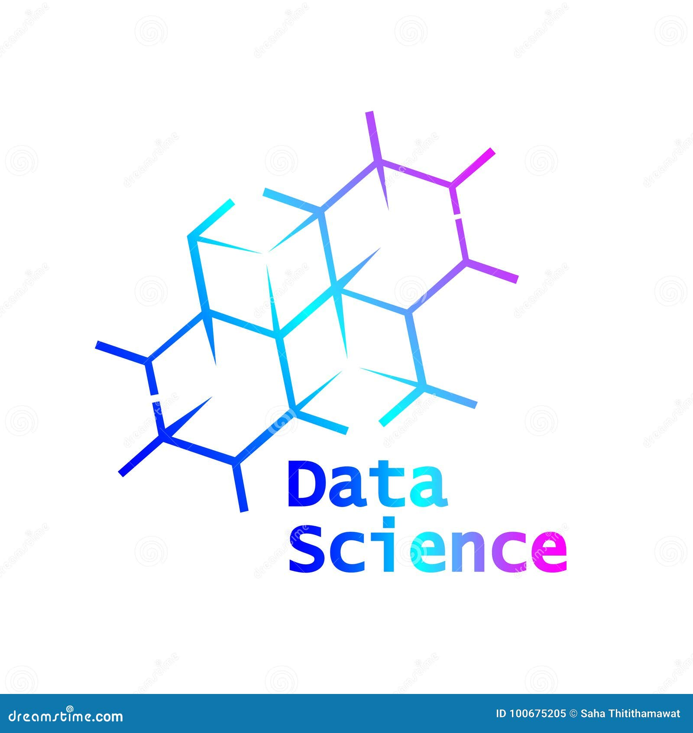
What is Data Science
Data science involves extracting insights and knowledge from data using statistical and computational techniques, aiding decision-making across various domains through data-driven approaches.

Slide 3

Data Science in Education
Data science in education harnesses advanced analytics to leverage educational data, empowering educators to personalize learning, identify trends, and optimize educational outcomes for students through evidence-based decision-making.

Slide 4
Data Science in Education
Educational data science will assist and train 'educators' or 'teachers' in order for them to improve their teaching style and have a better understanding of numerous strategies that engage students more.
Educators will be encouraged to incorporate data visualisation, data reduction and description, and prediction challenges into their curricula.
Data minimization will streamline the grading and assignment processes for students.
The data visualisation technique will assist students in absorbing complex data in a more simple manner and will be taught through a narrative approach.

Slide 5

Application of Data Science in Education
Personalized Learning: Data science enables the analysis of student performance data to tailor educational content and strategies to individual learning styles, preferences, and needs.
Predictive Analytics: Utilizing predictive modeling techniques, data science can forecast student outcomes, identifying at-risk students early and enabling timely intervention strategies to improve retention and academic success.

Slide 6
Application of Data Science in Education
Adaptive Learning Platforms: Data-driven adaptive learning systems adjust instructional content and pacing in real-time based on students' performance and interactions, enhancing engagement and facilitating mastery of concepts.
Learning Analytics: Data science enables the analysis of large-scale educational data to uncover patterns and trends in student behavior, engagement, and performance, informing instructional design, curriculum development, and policy decisions.
Student Success Initiatives: By leveraging data science techniques, educational institutions can develop targeted interventions and support services to enhance student satisfaction, progression, and overall academic achievement, fostering a conducive learning environment.

Slide 7
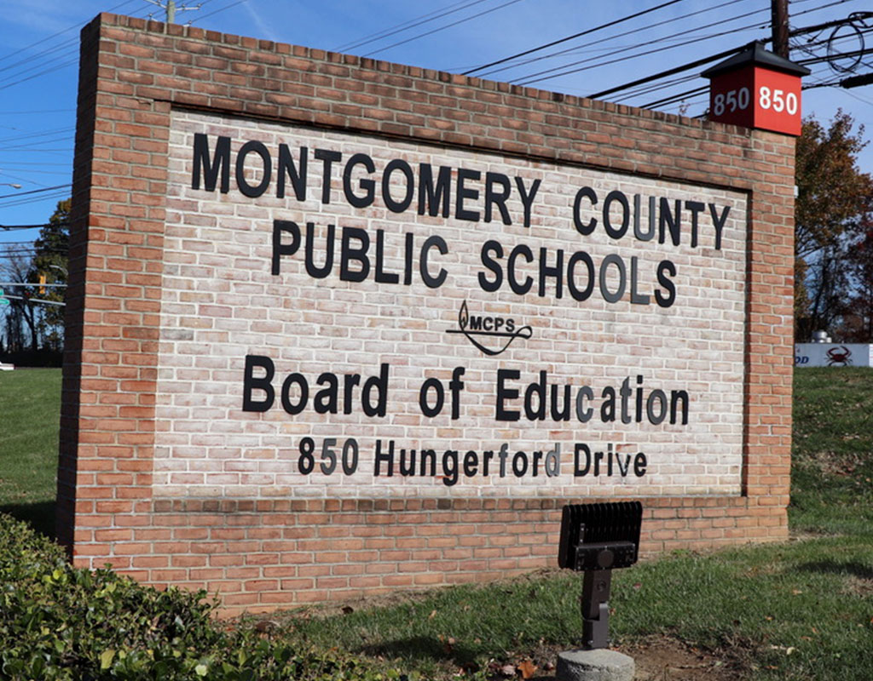
Enhancing Student Success at Montgomery County Public Schools (MCPS) Through Data-Driven Strategies
Case Study
Montgomery County Public Schools (MCPS) is a large public school district serving over 160,000 students in Montgomery County, Maryland. Committed to providing equitable and high-quality education, MCPS has implemented data-driven approaches to improve student outcomes.

Slide 8

Background :
MCPS faces challenges typical of many urban school districts, including achievement gaps, student retention, and resource allocation disparities. To address these challenges, MCPS has embraced data science as a powerful tool for informing decision-making and driving positive change.

Slide 9
Objective:
This case study aims to showcase how MCPS leveraged data science to enhance student success and address educational challenges within the district.
Methodology:
MCPS partnered with data analytics firms and educational researchers to develop and implement data-driven strategies. This involved collecting, analyzing, and interpreting various types of educational data, including student performance metrics, attendance records, demographic information, and teacher effectiveness data.

Slide 10
Data Collection:
MCPS utilized its comprehensive student information system to collect data on student demographics, academic achievement, attendance, and behavior. Additionally, the district partnered with external organizations to gather community data and socioeconomic indicators to better understand student needs.
Data Analysis:
Data scientists at MCPS employed advanced analytics techniques, such as predictive modeling and clustering analysis, to identify patterns and trends in student data. By analyzing factors contributing to student success and failure, MCPS gained valuable insights into effective interventions and support strategies.

Slide 11

Case Study Implementation:
MCPS implemented a variety of data-driven initiatives to support student success, including personalized learning plans, early warning systems for at-risk students, and targeted intervention programs. For example, the district developed individualized learning pathways for students based on their academic strengths and weaknesses, allowing for differentiated instruction and support.

Slide 12
Identification of Intervention Areas:
Based on the data analysis, MCPS identified intervention areas such as personalized learning, early warning systems, and targeted interventions to address specific student needs.
Development of Personalized Learning Plans:
MCPS developed individualized learning pathways for students based on their academic strengths and weaknesses, allowing for tailored instruction and support.
Implementation of Early Warning Systems:
MCPS implemented early warning systems to identify at-risk students based on factors such as attendance, behavior, and academic performance, enabling timely interventions to prevent academic disengagement.
Design and Delivery of Targeted Intervention Programs:
MCPS designed and delivered targeted intervention programs aimed at providing additional support and resources to students identified as at-risk through the early warning systems.

Slide 13
Differentiated Instruction and Support:
MCPS implemented differentiated instruction and support strategies within classrooms to accommodate diverse learning needs, ensuring that each student receives personalized attention and assistance.
Monitoring and Evaluation:
MCPS continuously monitored the effectiveness of its data-driven initiatives through ongoing data collection and analysis, making adjustments as needed to optimize outcomes.
Continuous Improvement:
MCPS fostered a culture of continuous improvement by regularly reviewing and refining its data-driven strategies based on feedback, research findings, and emerging best practices in education.
By following these steps, MCPS successfully implemented data-driven initiatives to support student success and enhance educational outcomes across the district.

Slide 14
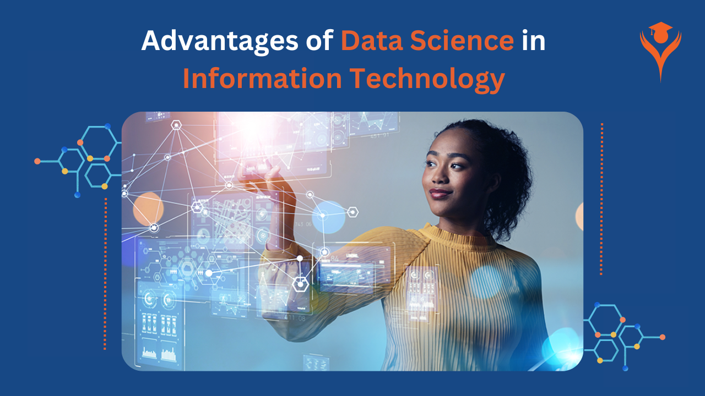
Results
Through its data-driven approaches, MCPS achieved significant improvements in student outcomes, including higher graduation rates, increased academic achievement, and reduced achievement gaps among student subgroups. By strategically allocating resources and interventions based on data analysis, MCPS was able to better meet the diverse needs of its student population.

Slide 15
Challenges and Solutions:
MCPS encountered challenges related to data privacy, data quality, and staff training in data literacy. To address these challenges, the district invested in professional development for staff, implemented robust data governance policies, and prioritized transparency and accountability in data use.
Lessons Learned:
MCPS learned the importance of building a culture of data-informed decision-making, fostering collaboration between stakeholders, and continuously evaluating and refining data-driven strategies to ensure effectiveness.

Slide 16
Conclusion:
The success of MCPS in improving student outcomes through data-driven strategies demonstrates the transformative potential of data science in education. By leveraging data to inform decision-making and drive continuous improvement, MCPS has created a more equitable and responsive educational environment for its students. Based on its experiences, MCPS recommends that other school districts prioritize data literacy training for staff, invest in robust data infrastructure, and cultivate partnerships with external data experts to maximize the impact of data-driven initiatives.

Slide 17
Thank You

